Slide 1

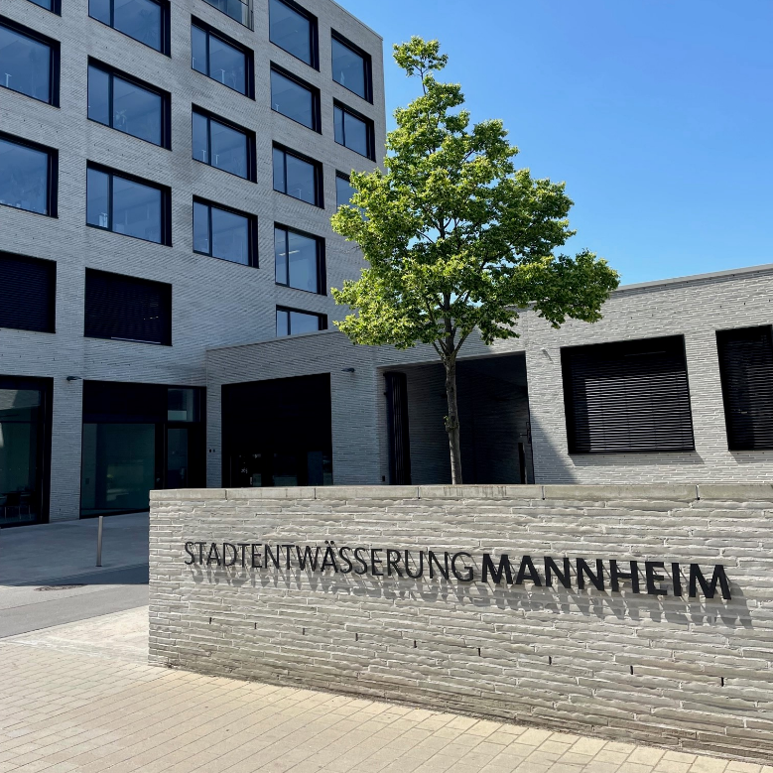
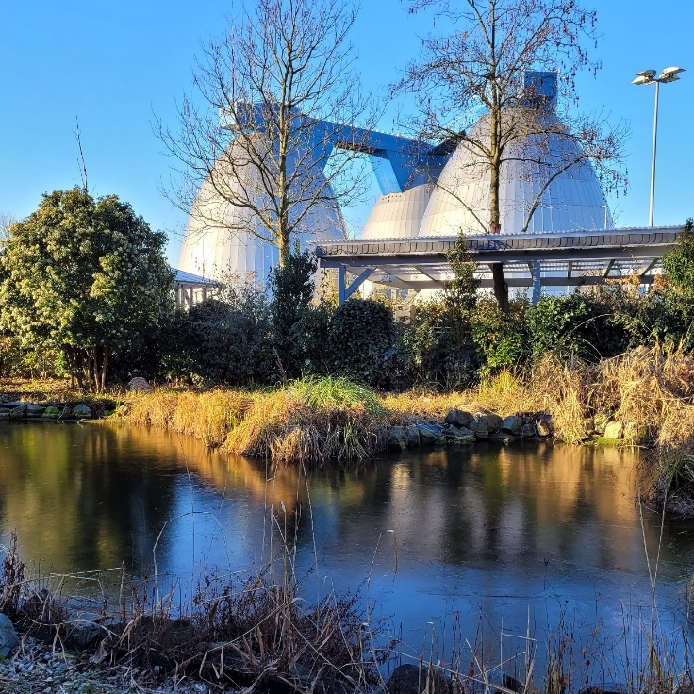
EBS MANNHEIM –
WASTEWATER
DEPARTMENT CITY OF
MANNHEIM

Slide 2
TABLE OF CONTENTS
Who we are
Data and facts
Locations and employees
Organisation
Distribution of staff
Charges and expenses
Expense distribution
Sewage disposal
Age structure of sewers
Sewerage system inspection
Sewer database
Renovation and construction of sewer
Wastewater treatment plant
Environmental performance
Material balance
Activated carbon plant
Renewable energies

Slide 3
Who we are
The Eigenbetrieb Stadtentwässerung (EBS) is a modern municipal service provider.
Its task is to drain and treat wastewater from households and industry as well as rainwater throughout the city and return it to the natural water cycle, the Rhine receiving watercourse.
This is done according to the best available technology and in compliance with legal requirements. The avoidance of health hazards and the protection of water bodies and the environment have the highest priority.

Slide 4
DatA and facts
Foundation 1997-01-01
Employees 260
Fixed assets 343 Mio. €
Investment 12,6 Mio. €
Quality and Environmental Management System
Certified according to EN ISO 9001 / EN ISO 14001 since 2003-01
Operators of critical infrastructure according to BSI law

Slide 5
DatA and facts
Sewage treatment plant 725.000 population equivalents (design size)
approx. 92,600 m³ wastewater flow per day
Sewage system 842 km (without house connection sewers)
combined discharge
39 pumping stations 32 lifting equipments
Rain-/storm water treatment 8 overflow basins
8 storm water retention tanks 12 storage capacities of sewer 2 rainwater infiltration facilities
Retention volume in total approx. 170.000 m³

Slide 6
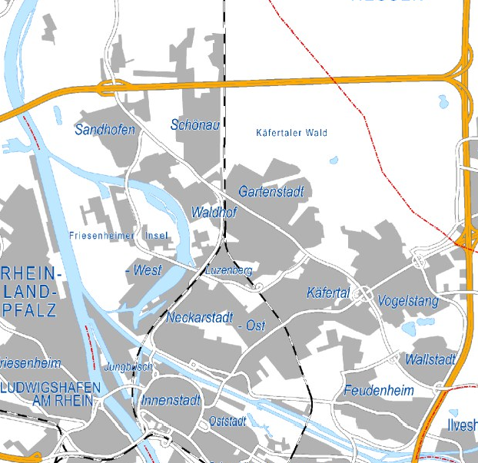
Locations and employees
Wastewater treatment
155 employees
Karl-Imhoff-Straße 50
68307 Mannheim
Sewerage disposal and administration
105 employees
Käfertaler Straße 265
68167 Mannheim

Slide 7
Organisation
Managing Director
Managing Director Assistant
Staff Council for civil servants
Quality / Environmental Management
Water Pollution Control Deputy
Public Relations
IT Security Deputy
Energy management
Financial
Department
Sewerage Disposal Department
Wastewater Treatment Department
Human Ressources / Organisation
Special Buildings
Wastewater Treatment
Accounting/ Finance
Planning and Construction
Machine technology
Controlling / Charges
Sewerage System
Electronical, Measurement and Control Technology
Sewerage Pipe System
Wastewater Chemistry

Slide 8
Distribution of Staff
Total numbers of employees: 260

Slide 9
Wastewater charges and expenses
Sewage fees
Per cubic metre of delivered drinking water 1,96 € (since 2025-01-01, before 1,68 €)
Rain water fees
Per square metre and year of drained surface 0,72 € (since 2025-01-01, before 0,80 €)
Income (Wastewater Charges) 58,7 Mio. €
Material costs 15,9 Mio. €
Personnel costs 19,9 Mio. €
Depreciations 15,6 Mio. €
Financial result 21,3 Mio. €

Slide 10
Expense distribution

Slide 11
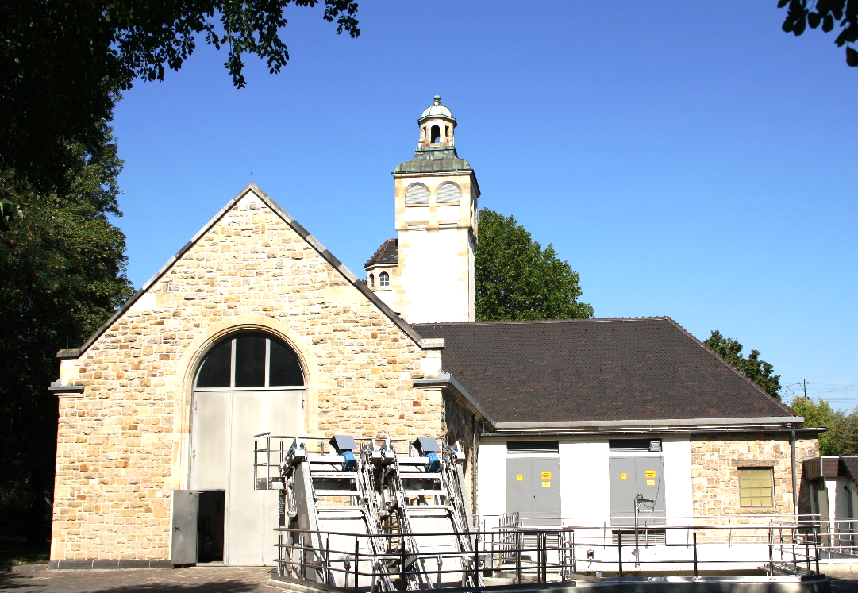
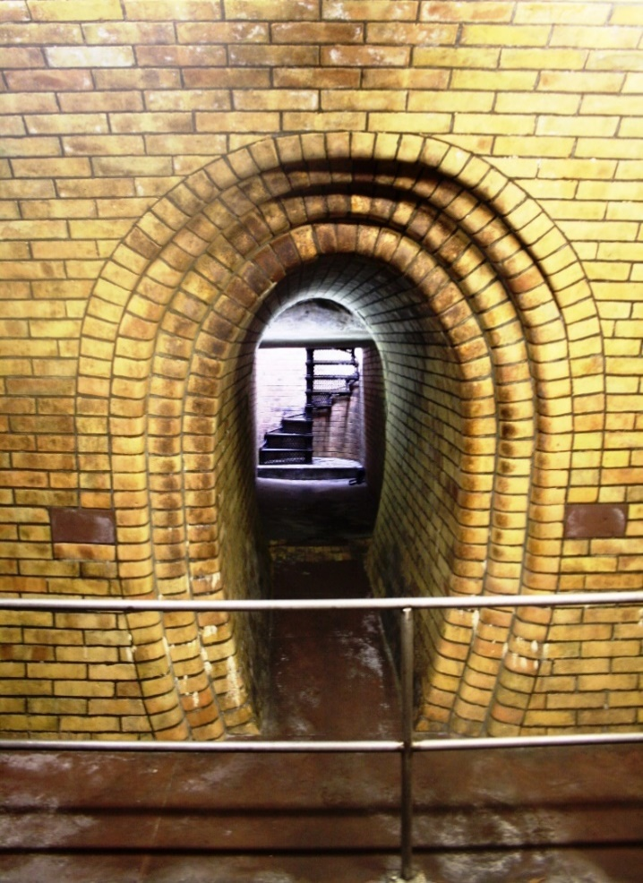
Sewerage disposal
Sewerage system length
842 km under the responsibility of EBS Mannheim
Year of sewerage system construction
since 1876
Sewer section
250 – 5.200 mm
Canalized area
approx. 7.100 ha
Connection to sewerage system
99,9 %

Slide 12
Age structure of sewers

Slide 13
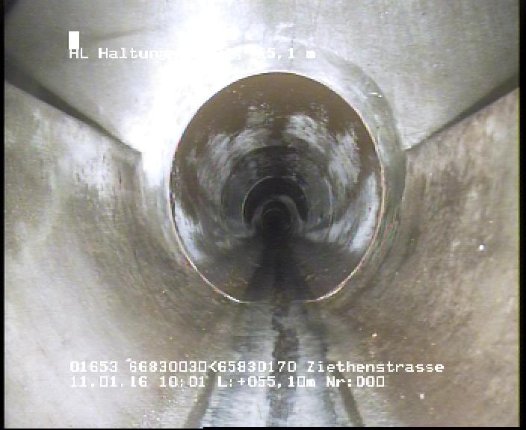
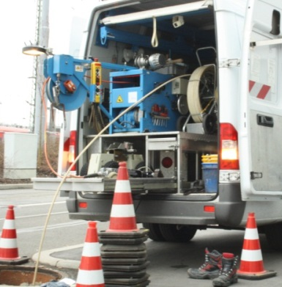
Sewerage system inspecton
Digital based on TV examination (since 1986) 95 %
Analog based on walking through 5,0 %
Examination in total 100 %

Slide 14
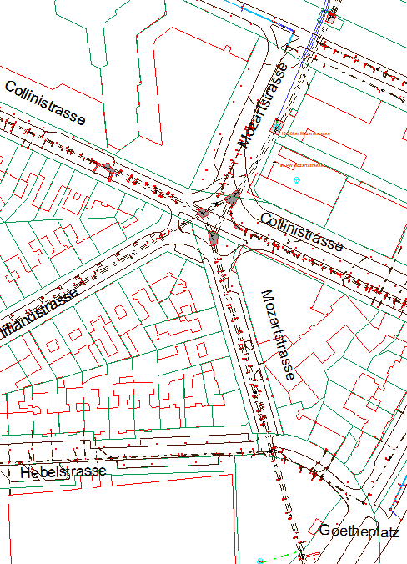
Sewer database
Administration of the sewer inventory data for the whole urban area
Survey data (channel geometry and topography)
Data from the TV-Inspection – Gathering of the sewer conditions
Gathering of the house connections (noozles)
Special buildings
Hydraulic performance of the sewer system
Indirect discharge data
Data of the plants

Slide 15
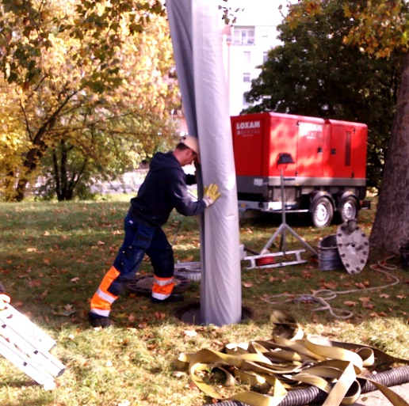
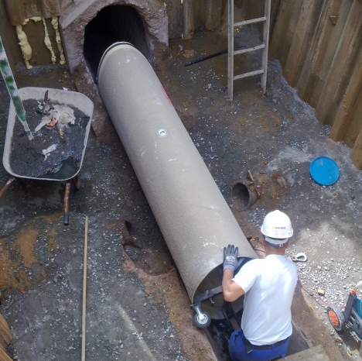
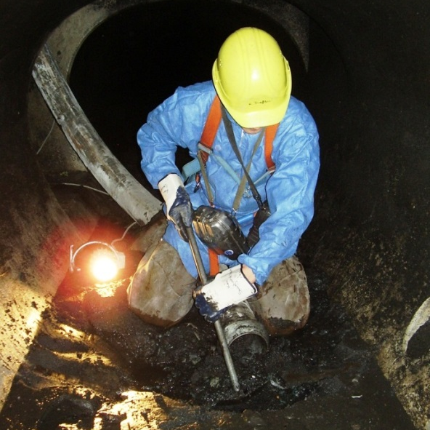
Renovation and construction of sewer
Length in total of
repaired sewer : approx. 2,6 km
renovated sewer : approx. 2,7 km
renewed sewer: approx. 1,0 km
In the DWA performance comparison, EBS regularly occupies the top position among the 862 wastewater treatment plants in Baden-Württemberg.

Slide 16
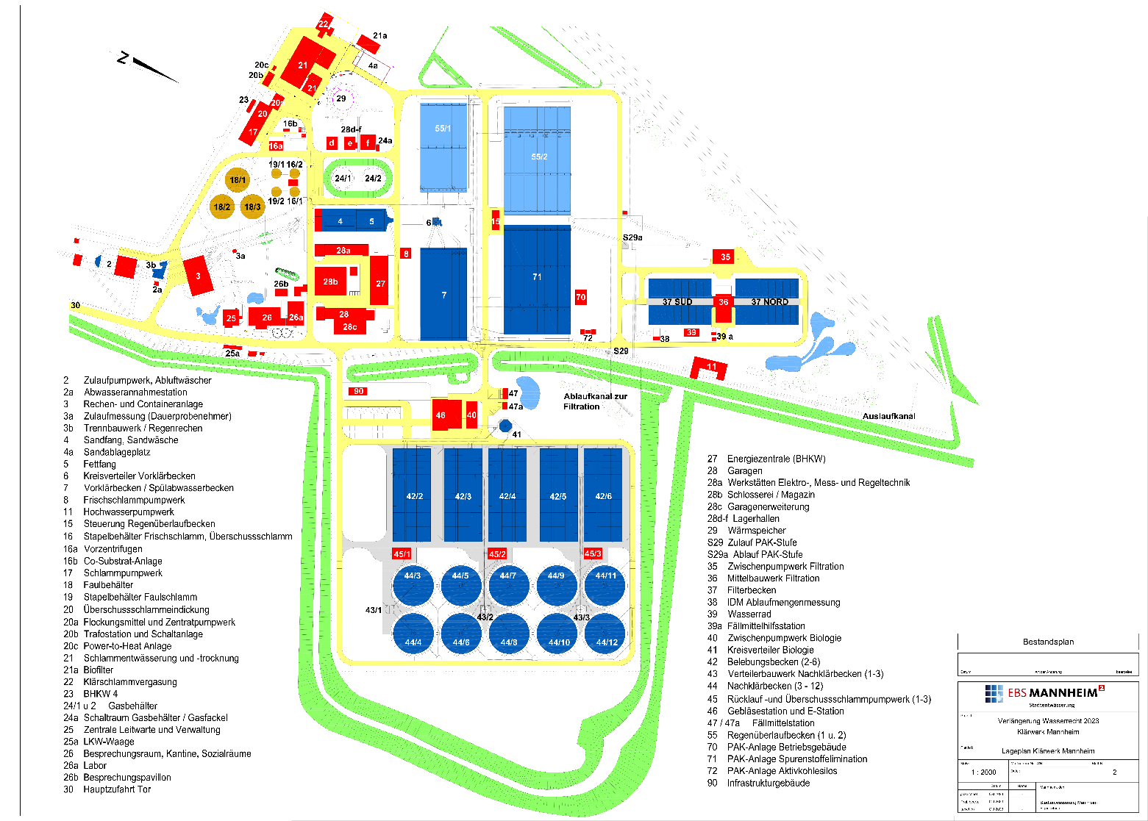
Wastewater treatment plant
Operation
1973 Wastewater treatment plant
1986 Filtration
1999 New Biology
2016 Fourth treatment stage
2022 Heat accumulator
Flow of wastewater at dry weather
Conditions per day: approx. 92.600 m³
725.000 population equivalents (design
size), approx. 50% from the industry

Slide 17
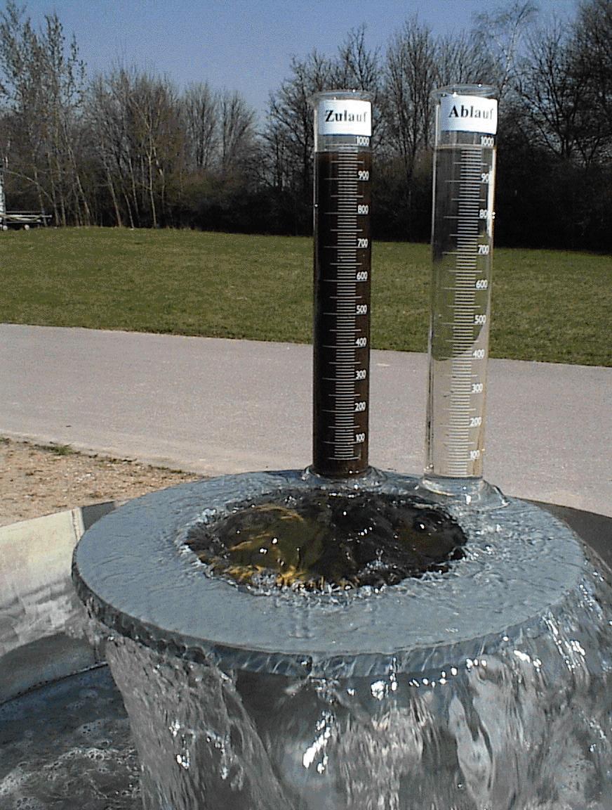
Enviromental performance (as of 2024)
 |  | Raw waste water mg/l | Treated waste water mg/l | Efficiency level %
Chemical oxygen demand | COD | 811 | 17 | 97,9
Organic carbon in total | TOC | 279 | 5,92 | 97,9
Nitrogen in total | N_{tot} | 64,4 | 4,2 | 93,4
Phosphor | P_{tot} | 11,83 | 0,11 | 99,1
In the DWA performance comparison, EBS regularly occupies the top position among the 862 wastewater treatment plants in Baden-Württemberg.

Slide 18
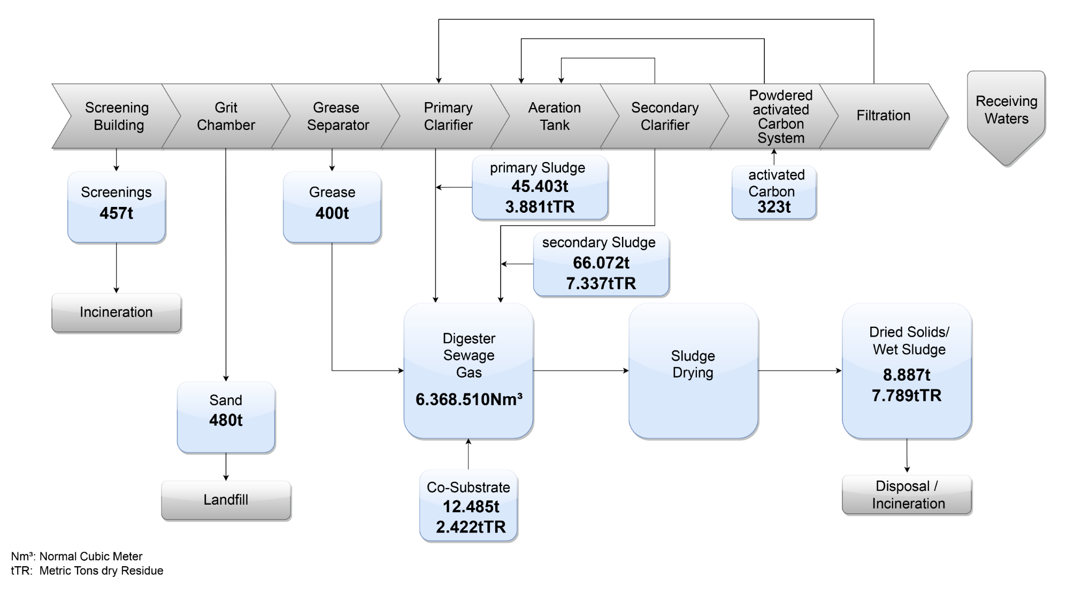
Material Balance (AS OF 2024)
Inflow: approx. 33,88 Mio. m³ wastewater inflow per year (approx. 92.600 m³ wastewater inflow per day)

Slide 19
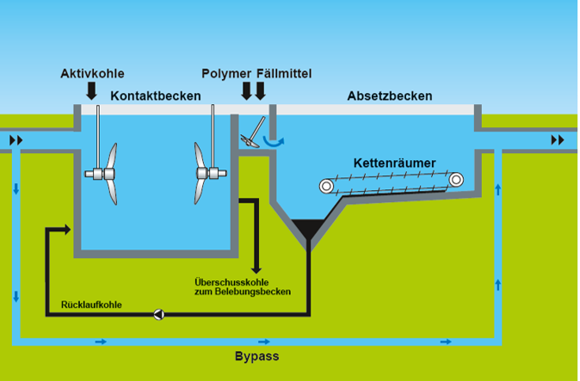
ACTivated CARBON PLANT
which was first realized on a large scale in Mannheim
Micropollutants are being removed from wastewater by dosing powdered activated carbon.
Micropollutants consist of residues from pharmaceuticals, X-ray contrast media, chemicals from industries and households, aromatic substances, etc.
5 parallel tanks
Maximum flow 2200 l/s, 90% of the annual wastewater flow are being treated

Slide 20
ENVIRONMENTAL AND WATER PROTECTION
Removal of microplastics
The purification stages in the sewage treatment plant with final filtration ensure that microplastic particles are almost completely removed from the wastewater flow
Resource-conserving use of water
Use of high-pressure flushing vehicles with water recovery
Wastewater treatment plant mainly covers water requirements with treated wastewater
Removal of micropollutants with activated carbon
Large-scale plant eliminates trace substances by more than 80
Habitats for animal and plant species are created in the sewage treatment plant
Numerous trees, shrubs, orchards and wild herb meadows were planted and several ponds were created on the grounds of the sewage treatment plant
Grass areas are grazed by flocks of sheep

Slide 21
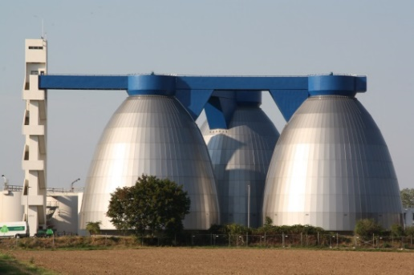
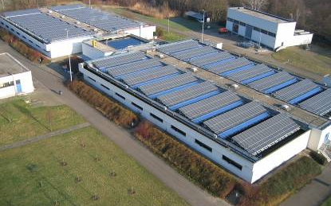
Renewable energies and Resource Conservation
Around 70 % of the energy required to operate the sewage treatment plant can be provided by self-generated heat and electricity
Sewage gas produced from sewage sludge in the digesters accounts for the largest share
The sewage gas produced is converted into heat and electricity in combined heat and power plants and via a boiler system
Additional power generation via photovoltaic system and water wheel

Slide 22
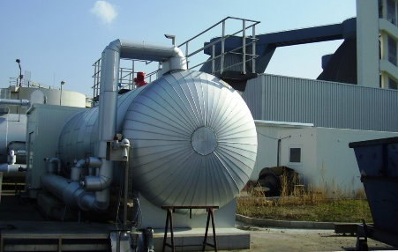
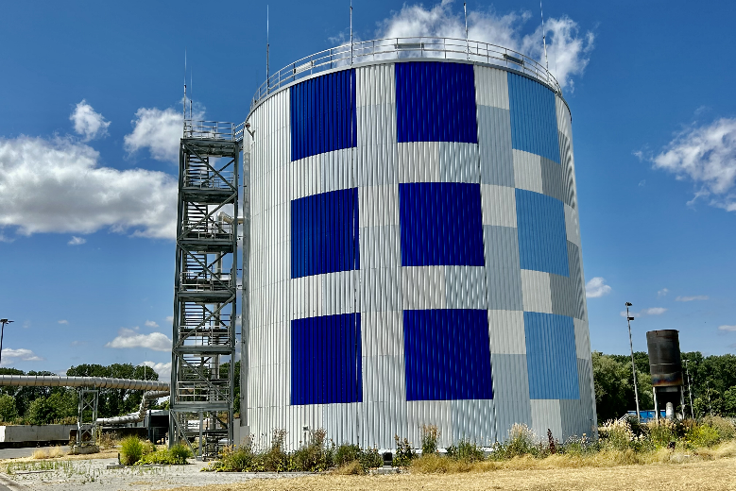
Renewable energies and Resource Conservation
Additional sewage gas can be produced by feeding co-substrates into the digesters
A 5,000 m³ heat storage tank enables stable system operation, as the stored heat can be made available as required
A power-to-heat system supports the composition of the energy mix, as it stores temporary electricity surpluses in heat
Utilization of wastewater heat in the sewer system through the use of heat pumps and heat exchangers

Slide 23
Thank you for your attention.
Stadtentwässerung Mannheim
Käfertaler Straße 265
68167 Mannheim
Phone.: 0621 293-5210
Fax: 0621 293-5211
Mail: stadtentwaesserung@mannheim.de
Status: December 2024

